Slide 1
Layout

Slide 2
Agenda
Introduction to Layouts in Android
Linear Layout
Table Layout
Relative Layout
Frame Layout
Grid Layout
ScrollView
Advanced Layout Techniques and Best Practices

Slide 3
What are Layouts
Layouts in Android are container elements that define the structure and arrangement of user interface (UI) components on the screen.
They determine how UI elements like buttons, text fields, images, and other widgets are displayed and interact with each other.

Slide 4
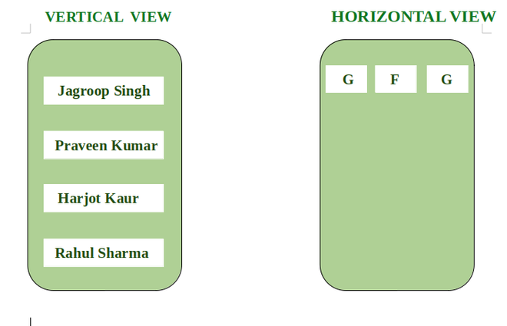

Slide 5
Purpose of Layouts:
Organization: Layouts help organize UI components in a structured manner, making the app more intuitive and user-friendly.
Responsiveness: They ensure that the UI adapts to different screen sizes and orientations, providing a consistent user experience across devices.
Hierarchy: Layouts establish a hierarchy of views, where each view can contain other views, enabling complex UI designs.
Management: They manage the positioning and sizing of UI components, ensuring that elements are displayed correctly according to design specifications.

Slide 6
Note
In Android, layouts are typically defined in XML files, which provide a clear and human-readable way to specify the UI structure.
Each layout file corresponds to a screen or a portion of the screen in the app, allowing developers to design the UI visually.
Android provides various built-in layout classes, each serving a specific purpose and offering different ways to position and arrange child views.

Slide 7
The role of layouts in organizing and structuring the UI components:
Layouts act as containers for other UI elements, determining their position and size relative to each other and the parent container.
They enable the creation of flexible and dynamic interfaces by allowing views to be arranged in different configurations.
By using layouts effectively, developers can create complex and visually appealing UIs that are easy to navigate and interact with.

Slide 8
LinearLayout
LinearLayout is a type of layout in Android that arranges its child views in a single direction, either horizontally or vertically.
It is one of the most commonly used layouts due to its simplicity and straightforward behavior.
Key Points:
Single Direction: All child views are placed in a single row or column, depending on the orientation specified.
Orientation: The orientation attribute determines whether the layout is arranged horizontally or vertically.

Slide 9
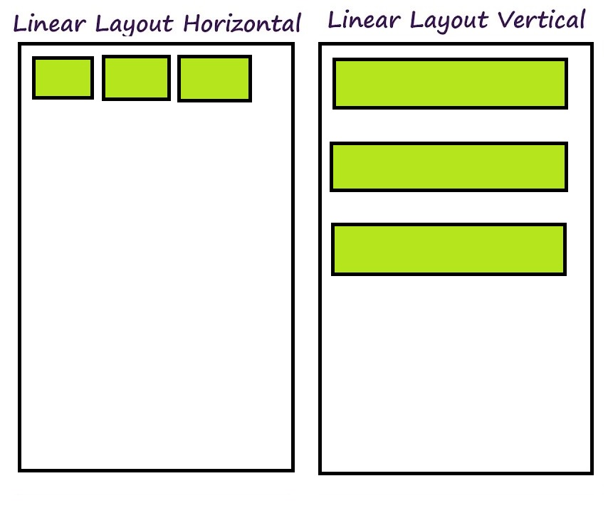

Slide 10
LinearLayout is ideal for scenarios where you need to align multiple UI components in a single direction. Common use cases include:
Simple Forms: When designing forms with labels and input fields aligned either vertically or horizontally.
Vertical Lists: For example, a list of items where each item is stacked vertically, such as a vertical list of buttons or text fields.
Horizontal Lists: For example, a row of buttons or images arranged side by side.
Stacked Elements: For creating stacked elements that follow a specific order, like a column of text and images.

Slide 11
Attributes
1. orientation
Description: Defines the direction in which child views are arranged.
Values:
vertical: Arranges child views in a vertical column.
horizontal: Arranges child views in a horizontal row.
<LinearLayout
android:layout_width="match_parent"
android:layout_height="wrap_content"
android:orientation="vertical">
<!-- Child views here -->
</LinearLayout>

Slide 12
2. gravity
Description: Controls the alignment of child views within the LinearLayout.
Values:
top, bottom, left, right, center, etc.
<LinearLayout
android:layout_width="match_parent"
android:layout_height="wrap_content"
android:orientation="horizontal"
android:gravity="center">
<!-- Child views here -->
</LinearLayout>

Slide 13
3. layout_weight
Description: Specifies how much of the extra space in the LinearLayout should be allocated to each child view.
Values:
A floating-point number representing the proportion of extra space.

Slide 14
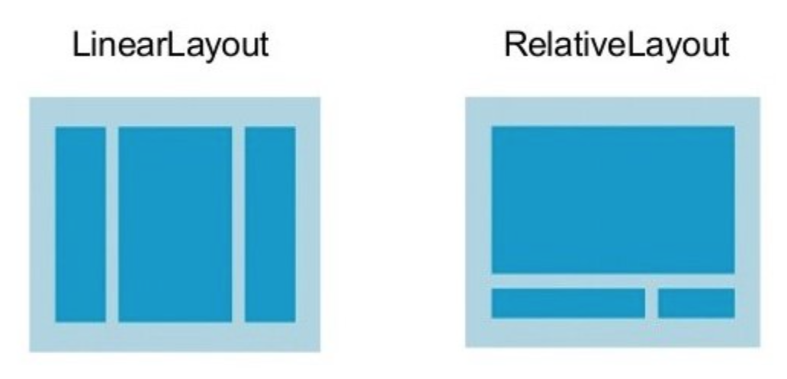
RelativeLayout:

Slide 15
RelativeLayout is a versatile layout in Android that allows you to position child views relative to each other or to the parent container.
This flexibility makes it suitable for creating complex UI designs where views need to be aligned based on their relationship to other views or the parent layout.

Slide 16
Key Points:
Positioning Relative to Parent: You can align child views relative to the edges of the parent container (e.g., top, bottom, left, right).
Positioning Relative to Sibling Views: You can position views relative to other views within the same layout (e.g., below, to the right of another view).
Overlap and Layering: Allows overlapping of views, which can be useful for certain design patterns.

Slide 17
RelativeLayout is ideal for scenarios where you need precise control over the positioning of UI components relative to each other or the parent.
Common use cases include:
Complex Layouts: When designing interfaces where views need to be aligned relative to each other or to the parent container.
Adaptive UIs: Layouts that adjust based on different screen sizes and orientations, where views need to be dynamically repositioned.
Custom Alignments: Situations where standard layouts (like LinearLayout) would require nested structures to achieve the desired positioning.

Slide 18
Attributes
layout_alignParentTop
Description: Aligns the top edge of the child view with the top edge of the parent container.
Values:
true: Aligns the view's top edge with the parent’s top edge.

Slide 19
<RelativeLayout
xmlns:android="http://schemas.android.com/apk/res/android"
android:layout_width="match_parent"
android:layout_height="wrap_content">
<Button
android:layout_width="wrap_content"
android:layout_height="wrap_content"
android:layout_alignParentTop="true"
android:text="Top Aligned Button" />
</RelativeLayout>

Slide 20
layout_below
Description: Positions the child view below another specified view.
Values:
Reference to another view ID (e.g., @+id/other_view_id).

Slide 21
<RelativeLayout
xmlns:android="http://schemas.android.com/apk/res/android"
android:layout_width="match_parent"
android:layout_height="wrap_content">
<TextView
android:id="@+id/first_view"
android:layout_width="wrap_content"
android:layout_height="wrap_content"
android:text="First View" />
<Button
android:layout_width="wrap_content"
android:layout_height="wrap_content"
android:layout_below="@id/first_view"
android:text="Button Below TextView" />
</RelativeLayout>

Slide 22
layout_toRightOf
Description: Positions the child view to the right of another specified view.
Values:
Reference to another view ID (e.g., @+id/other_view_id).

Slide 23
<RelativeLayout
xmlns:android="http://schemas.android.com/apk/res/android"
android:layout_width="match_parent"
android:layout_height="wrap_content">
<TextView
android:id="@+id/first_view"
android:layout_width="wrap_content"
android:layout_height="wrap_content"
android:text="First View" />
<Button
android:layout_width="wrap_content"
android:layout_height="wrap_content"
android:layout_toRightOf="@id/first_view"
android:text="Button to Right of TextView" />
</RelativeLayout>

Slide 24
RelativeLayout provides flexible positioning of child views relative to each other and the parent container.
layout_alignParentTop aligns a view with the top of the parent.
layout_below places a view below another view.
layout_toRightOf positions a view to the right of another view.

Slide 25
FRAMES LAYOUT
Frame Layout is one of the simplest layout managers available in Android.
It serves as a container that can hold one or more child views (UI components) such as buttons, text views, images, etc.
However, unlike more complex layouts like LinearLayout or RelativeLayout, Frame Layout is designed to be minimalist in terms of positioning and arrangement capabilities.
Its main function is to act as a basic structure for placing child views, typically used when you want these views to overlap or be stacked on top of each other.

Slide 26
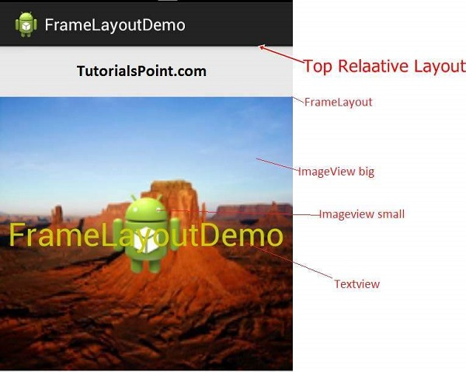

Slide 27
Why to use it
The primary purpose of Frame Layout is to facilitate stacking of views.
When multiple views are added to a Frame Layout, they are layered one on top of the other, with the last added view appearing on top.
This makes Frame Layout ideal for situations where you need overlapping elements, such as displaying text over an image, or overlaying a loading spinner on top of other content.

Slide 28
Characteristics
A key characteristic of Frame Layout is that, by default, it positions all its child views at the top-left corner of the screen (or container).
This default behavior makes it easy to create simple overlays, but it can be limiting if you require more complex positioning or alignment of views.
Additional properties like layout_gravity can be used to adjust the positioning of individual child views within the Frame Layout, but the overall simplicity remains a defining feature.

Slide 29
Properties of Frame Layout

Slide 30
android:foreground: Displays a drawable in front of its children
Why to use it
This property allows you to place a drawable (an image, shape, or other graphic element) in front of all the child views within the Frame Layout.
It’s particularly useful when you want to overlay a visual effect (like a shadow, gradient, or image) on top of all the content without altering the children’s layout.

Slide 31
Code
<FrameLayout
android:layout_width="match_parent"
android:layout_height="match_parent"
android:foreground="@drawable/overlay_image">
<!-- Child views go here -->
</FrameLayout>

Slide 32
How it behaves
The drawable specified by android:foreground will be drawn after all child views, making it appear on top of them.
You can also control the transparency or color of the foreground to achieve different visual effects.

Slide 33
Common Use
Adding a transparent overlay to darken or lighten the content.
Displaying a watermark or branding element over the content.
Creating visual feedback (e.g., highlighting a selected state).

Slide 34
2. android:layout_gravity: Controls the alignment of children within Frame Layout
Why to use it
The android:layout_gravity property determines how a child view is positioned within the Frame Layout.
Since Frame Layout by default places all child views at the top-left corner, layout_gravity provides a way to change this positioning to the center, bottom, right, or any combination of these.

Slide 35
<FrameLayout
android:layout_width="match_parent"
android:layout_height="match_parent">
<TextView
android:layout_width="wrap_content"
android:layout_height="wrap_content"
android:text="Hello, World!"
android:layout_gravity="center"/>
</FrameLayout>

Slide 36
Behavior: The layout_gravity value can be set to various constants like center, bottom, right, start, end, etc. When applied, it adjusts the position of the child view within the Frame Layout based on these constants.
Common Use Cases:
Centering content like a loading spinner in the middle of the screen.
Aligning text or buttons to the bottom-right corner of the layout.
Placing a logo or icon at the top-right of the layout.

Slide 37
3. android:measureAllChildren: Measures all children to the same size
By default, Frame Layout only measures the size of the visible child views, meaning if some views are set to GONE, they won’t be measured.
The android:measureAllChildren property, when set to true, forces the Frame Layout to measure all its children, even those that are not visible (GONE).

Slide 38
What is GridView?
GridView is a user interface component in Android that allows you to display items in a two-dimensional, scrollable grid.
It’s particularly useful when you want to display a large number of items in a structured and space-efficient manner.
Each item in the grid can be an image, text, or a more complex layout, depending on the needs of your application.

Slide 39
Use Cases:
Image Galleries: Displaying a collection of photos or images in a grid.
Product Listings: E-commerce apps often use GridView to showcase products in a grid layout, making it easier for users to browse through items.
File Managers: Displaying files or folders in a grid, similar to desktop icons.

Slide 40
Key Features:

